Slide 1





Sequencer Debugger
Low-level at your fingerprints
Project number: 22-1-2-2659
Student: Dor Golfaiz
ID: 316060805
Mentor: Michal Carmeli
Mentor’s Signature: Michal

Slide 2

The Project
The Project

Slide 3
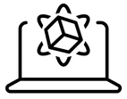
What are we debugging?
The Project
Recording Program
(DB + XML)
Compiled to…
Sequencer Code
( 0101101… )
What is the Sequencer?
A controller in the chip whose purpose is to control a basic flow of measurement: scanning over bands, transmitting, turning on/off modules at specific times, etc.
Its purpose is to release the external CPU from real-time operations and release the real-time requirements from the external CPU. (e.g., 4 minutes vs 100 ms)
9 instructions, ALU, Peripherals (Condition, Counters). Data Width (word): 2 bytes. Program Memory Size – 32K instructions (128 KB) Parameters Memory Size – 16K parameters (32 KB)

Slide 4
The Project
Main issues to remember:
Recording Program
(DB + XML)
Compiled to…
Sequencer Code
( 0101101… )
A question to think about …
Assuming we can generate a “breakpoint” code (some kind of a conditional wait)
How can we insert real-time breakpoints into a compiled code?
Don’t worry, we will answer it soon ☺

Slide 5
System Requirements

Slide 6

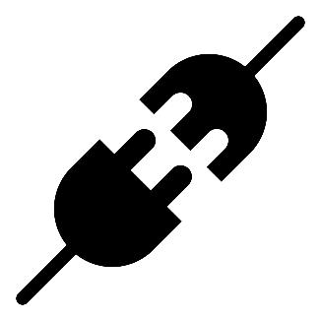
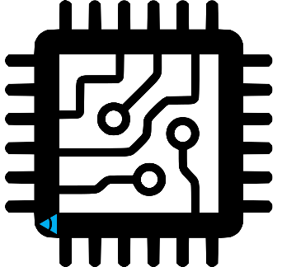
A Debugger Software Architecture
GUI
(Front)
Adapter
Debugger
(Back)

Slide 7
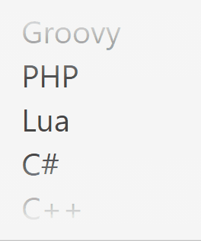
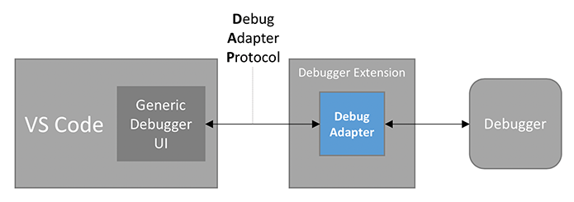
A Debugger Software Architecture
GUI
(Front)
VS Code for
“ VS Code allows you to easily integrate existing debuggers into VS Code, while having a common user interface with all of them ”
which means you can enjoy VS Code as our debugger GUI just by implementing the debug adapter which will connect the debugger to VS Code.
If you think about it, all the debuggers are the same…

Slide 8
A Debugger Software Architecture
GUI
(Front)
Adapter
Debugger
(Back)

Slide 9
A Debugger Software Architecture
Supported features by the debugger
Breakpoint functionality (incl. stepping)
Call stack
Local Variables (Read + Write)
Watchers (Read + Write)
Optional – Conditional Breakpoints,
Debugger
(Back)

Slide 10
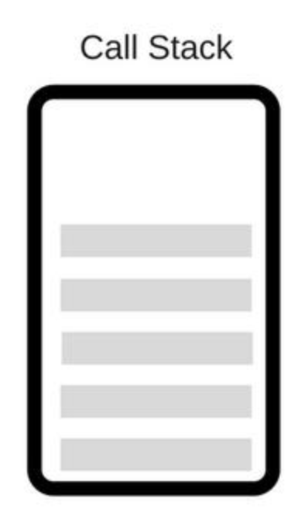
A Debugger Software Architecture
Debugger
(Back)
Lets say we have a breakpoint functionality,
How can we implement the following?
Stepping ?
Step In ?
Step Out ?

Slide 11
Block Diagram
Block Diagram

Slide 12
Block Diagram
Running the program Breakpoint Requests
Debugger Breakpoint Implementation
Stopping on breakpoint
Continue / Step
Running the program Breakpoint Requests
Debugger Breakpoint Implementation
Stopping on breakpoint
Continue / Step

Slide 13
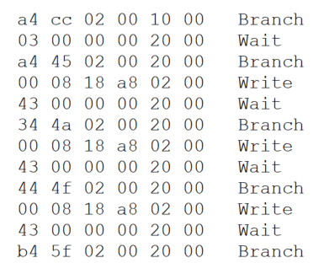
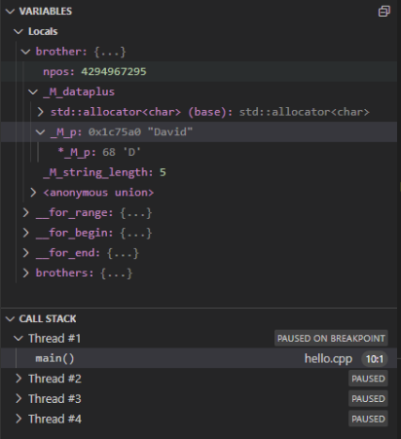

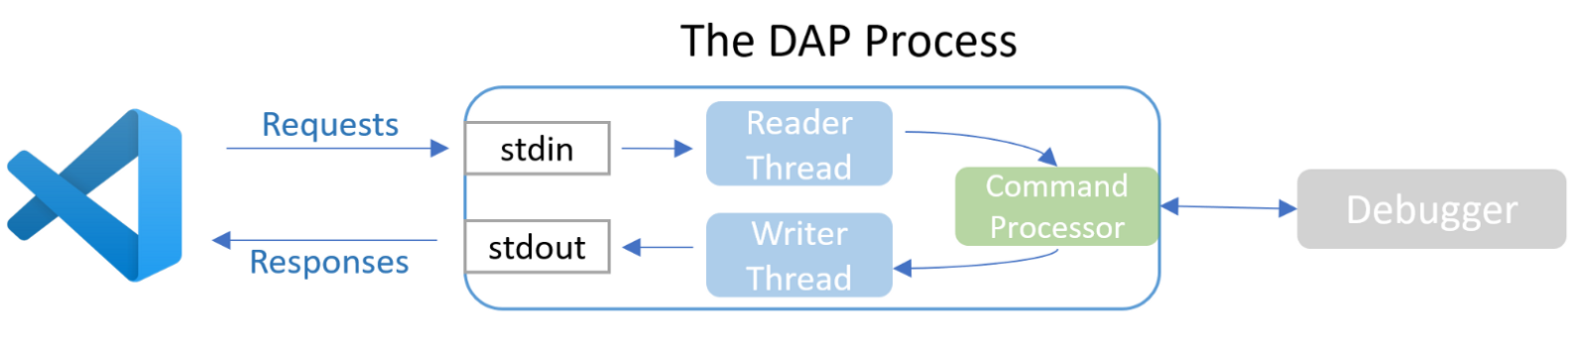
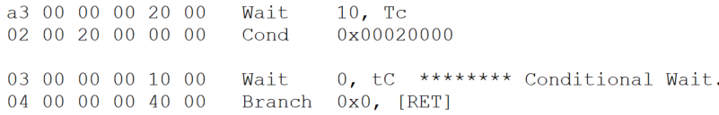
Block Diagram
Running the program Breakpoint Requests
Debugger Breakpoint Implementation
Jump to BreakPoint Block
Stopping on breakpoint
BreakPoint Block
Continue / Step

Slide 14
Product
So, what do we have so far?

Slide 15
Product
Breakpoint Loop
A series of opcodes, designed to keep the sequencer in a conditional wait
Was able to release the conditional wait by writing to a specific register
DAP - Command Processor module
Translates a DAP request to a function call that handles a given request
Logs handled requests and current status
Returns a response to DAP, letting VSCode know whether the handling was successful or failed.
Debugger API
Implements the functions called by Command Processor
Returns information needed for VSCode’s response.

Slide 16
Updated Schedule
Updated Schedule

Slide 17
Updated Schedule
אבן דרך | פירוט | תאריך יעד | הערות
המשך Command Processor | מימוש סופי של ה-Adapter, המכיל את ארגז הכלים הרצוי, והעברת כל פעולה שהתבצעה בו פקודה לדיבאגר, כך שהאבסטרקציה תושלם והדיבאגר יוכל להתחבר ל-GUI במאמץ מינימלי, וכל שעליו לעשות הוא לממש את האבסטרקציות הנ"ל על המעבד | 10.3.23
פיתוח Debugger | מימוש האבסטרקציות שפורטו לעיל – הכנסת Breakpoint, כתיבה לרגיסטרים, שמירת Call Stack אך כל זה ישירות על המעבד בעזרת צריבת אופקודים בזמן ריצה ישירות ל-IRAM. | 30.4.23
ניתוח התוצאות | השוואה וניתוח התוצאות לצד המטרות שהצגתי בתחילת העבודה על הפרויקט | 4.5.23
הרחבת הכלי | פיתוח והרחבת ה-Debugger בעזרת כלל ההצעות שהועלו במסמך זה- Syntax Highlighting, code navigation, etc.. | 20.5.23
הגשת פוסטר וסיום העבודה בפרויקט |  | 28.5.23
המשך - הרחבת הכלי | פיתוח והרחבת ה-Debugger בעזרת כלל ההצעות שהועלו במסמך זה- Syntax Highlighting, code navigation, etc.. | 20.6.23
הגשת ספר הפרויקט + מצגת הסיום |  | 29.6.23

Slide 18
Updated Schedule
Reasons for changes in the schedule
GUI Development – Instead of developing a GUI, I presented a way to use VSCode’s well-known and easy-to-use debugging flow, while debugging sequencer code – using DAP. So GUI implementation is off the table.
Testing the debugger – The stage of testing the debugger was removed, since instead of testing on some sequencer code that does nothing, I decided to test it on real operational Vayyar Sequencer Code, and I can check that I stopped in a breakpoint using a scope.
The biggest part of the new scheduled work plan is to implement the debugger – making it work for every case, for example stepping at the end of a function, stepping out of functions, adding watchers, etc. That is the crucial part.

Slide 19
Thank You
Vayyar Imaging Confidential

